Slide 1
Chapter 1
Arithmetic of Whole Numbers
Section 1.4
Division of Whole Numbers
Notes:
1

Slide 2
Objective:
Divide Whole Numbers
Determine Factors and Prime Factors
Solve Practical Applications Involving Whole Numbers

Slide 3
Division
Division is the reverse of multiplication. It enables us to separate a given quantity into equal parts.
The mathematical phrase 12 $÷$ 3 is read “twelve divided by three,” and it asks us to separate a collection of 12 objects into 3 equal parts.
The mathematical phrases
all represent division, and they are all read “twelve divided by three.”

Slide 4
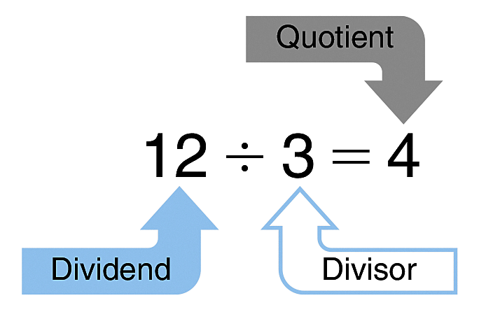
Division
In this division problem, 12, the number being divided, is called the dividend; 3, the number used to divide, is called the divisor; and 4, the result of the division, is called the quotient, from a Latin word meaning “how many times.”

Slide 5
Division
One way to perform division is to reverse the multiplication process.
means that
If the one-digit multiplication facts are firmly in your memory, you will recognize immediately that = 6.

Slide 6
Division by One and Zero
Recall that the product of any number and 1 is that same number. The same holds true for division. If you divide any number by 1, the quotient is the original number.
8 $÷$ 1 = 8
34 $÷$ 1 = 34
However, division by zero has no meaning in arithmetic.
(Any number) $÷$ 0 or is not defined.
But 0 $÷$ (any number) or

Slide 7
Example
Here is a step-by-step explanation of the division of whole numbers:
Divide 96 $÷$ 8 = _______.
First, estimate the answer: 100 $÷$ 10 = 10. The quotient or answer will be about 10.
Second, arrange the numbers in this way:
Notice that the order in which the numbers are written is reversed. With the $÷$ symbol, the divisor (8) is on the right. With the symbol, the divisor is on the left.

Slide 8
Example
Here is a step-by-step explanation of the division of whole numbers:
Divide 96 $÷$ 8 = _______.
Third, divide using the following step-by-step procedure:
1
8 into 9? Once. Write 1 in the answer space above the 9.
Step 1
1
Step 2
Multiply 8 $×$ 1 = 8 and write the product 8 under the 9.
8

Slide 9
Example Continued
Here is a step-by-step explanation of the division of whole numbers:
Divide 96 $÷$ 8 = _______.
1
Subtract 9 – 8 = 1 and write 1. Bring down the next digit, 6.
Step 3
– 8
1
6
1
2
Step 4
8 into 16? Twice. Write 2 in the answer space above the 6.
– 8
1
6

Slide 10
Example Continued
Here is a step-by-step explanation of the division of whole numbers:
Divide 96 $÷$ 8 = _______.
1
2
Multiply 8 $×$ 2 = 16 and write the product 16 under the 16.
Step 5
– 8
1
6
– 16
Step 6
0
Subtract 16 – 16 = 0. Write 0.
Finally, check your answer. The answer 12 is roughly equal to the original estimate 10. As a second check, multiply the divisor 8 and the quotient 12. Their product should be the original dividend number, 8 $×$ 12 = 96, which is correct.

Slide 11
Example
To calculate 153 $÷$ 4,
Quotient
3
8
Divisor
Dividend
– 12
3
3
– 32
1
Remainder
To check an answer with a remainder, first multiply the quotient by the divisor, then add the remainder. In this example,
38 $×$ 4 = 152
152 + 1 = 153, which checks.

Slide 12
Example
?
5084 $÷$ 31 = ________
Estimate: This is roughly about the same as 5000 , 30 or 500 , 3 or about 200. The quotient will be about 200.

Slide 13
Example
?
5084 $÷$ 31 = ________
31 into 5? No. 31 into 50? Yes, once. Write 1 above the zero.
1
6
4
Step 1
Step 2
31 $×$ 1 = 31. Subtract 50 – 31 = 19.
– 31
1
9
8
Bring down 8. 31 into 198? Yes, 6 times; write 6 in the answer.
Step 3
– 186
12
4
Step 4
31 $×$ 6 = 186. Subtract 198 – 186 = 12.
– 124
0
Bring down 4. 31 into 124? Yes, 4 times; write 4 in the answer.
Step 5
Step 6
31 $×$ 4 = 124. Subtract 124 – 124 = 0.
The estimate is reasonably close to the answer.
Double-check: 31 $×$ 164 = 5084.

Slide 14
Factors
It is sometimes useful in mathematics to be able to write any whole number as a product of other numbers.
If we write 6 = 2 $×$ 3 2 and 3 are called factors of 6
We could also write
6 = 1 $×$ 6 and see that 1 and 6 are also factors of 6.
The factors of 6 are 1, 2, 3, and 6.
The factors of 12 are 1, 2, 3, 4, 6, and 12.
The factors of 30 are 1, 2, 3, 5, 6, 10, 15, and 30.
Any number is exactly divisible by its factors; that is, every factor divides the number with zero remainder.

Slide 15
Primes
A prime number is one for which there are no factors other than 1 and the prime itself.
Here is a list of the first 15 prime numbers:
2, 3, 5, 7, 11, 13, 17, 19, 23, 29, 31, 37, 41, 43, 47
Notice that 1 is not listed. All prime numbers have two different factors: 1 and the number itself. The number 1 has only 1 factor—itself.

Slide 16
Prime Factors
The prime factors of a number are those factors that are prime numbers.
For example, the prime factors of 6 are 2 and 3.
The prime factors of 30 are 2, 3, and 5.
The concept of prime factors is useful when working with fractions.
To find the prime factors of a number a factor tree is often helpful.

Slide 17
Example
Find the prime factors of 132.
First, write the number 132 and draw two branches below it.
Second, beginning with the smallest prime in our list, 2,
test for divisibility. 132 = 2 $×$ 66. Write the factors below
the branches.
Next, repeat this procedure on the nonprime factor, 66,
so that 66 = 2 $×$ 33.
Finally, continue dividing until all branches end with a prime.
Therefore, 132 = 2 $×$ 2 $×$ 3 $×$ 11.
Check by multiplying.
132
2
66
2
33
3
11

Slide 18
Practical Applications
Whenever we need to separate some numerical quantity into equal parts, we use division. The quantity that we are separating is the dividend. If the divisor is the numerical value of its equal parts, then the quotient will tell us how many equal parts there are. If the divisor is the number of equal parts, then the quotient will tell us the value of each equal part.

Slide 19
Example
Suppose a carpenter needs to cut pieces of wood, each 20 inches long, from a 144-inch-long board. To determine how many pieces he can cut, use division:

Slide 20
Example Continued
Divide:
7
140
4
The quotient tells us that he can cut 7 of the 20-inch pieces from the board, and the remainder tells us that he will have 4 inches left over.

Slide 21
Learning Help
Another clue that indicates division is the word per. Whenever you are asked to find the number of “A per B,” you will always need to divide the number A by the number B.

Slide 22
Payback Time
The term payback time is used to describe the amount of time it takes for the savings in ongoing costs to match the initial investment made to purchase a technology. After that, the continued savings will make the new technology a more cost-effective alternative.

Slide 23
Example
A family made an initial investment of $14,850 to install solar panels on the roof of their house. Before using solar power, their monthly electricity
bills averaged $120. After installing the solar panels, their monthly bills averaged $10. To calculate the payback time for the solar panels,
First, calculate the monthly savings.

Slide 24
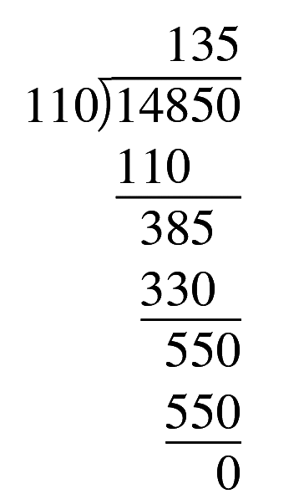
Example Continued
Then, divide the monthly savings into the initial investment to determine the payback time in months.
The payback time is 135 months. Notice that we used division to separate a total
($14,850) into equal monthly parts whose value ($110) was known. The quotient told us the number of equal parts (135 months).

Slide 25
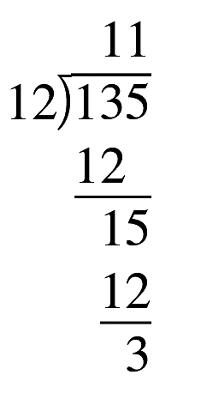
Example Continued
Finally, we can convert this to years. Simply divide this answer by 12—the number of months in a year.
The quotient, 11, is the number of whole years, and the remainder 3 is the number of
additional months. The payback time for the solar panels can thus be expressed as
11 years and 3 months. After that, the family will be saving money on electricity.

Slide 26
Division “Tricks of the Trade”

Slide 27
Division “Tricks of the Trade”

Slide 28
Division “Tricks of the Trade”

Slide 29
Division “Tricks of the Trade”

