Slide 1
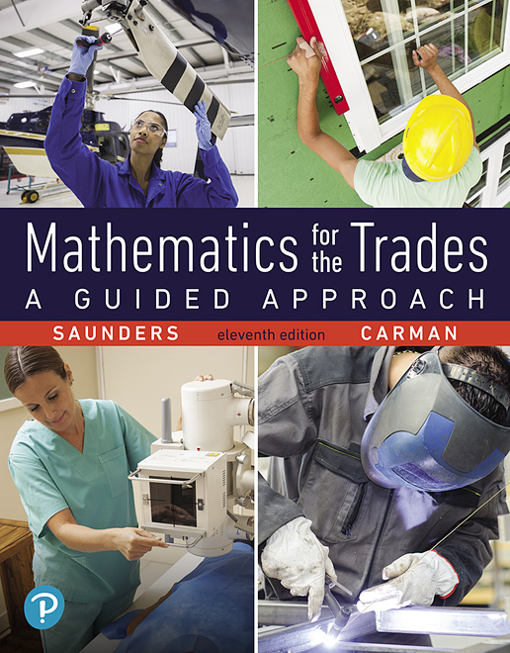
Chapter 1
Arithmetic of Whole Numbers
Section 1.3
Multiplication of Whole Numbers
Notes:
1

Slide 2
Objective:
Multiply Whole Numbers
Solve Practical Applications Involving Whole Numbers

Slide 3
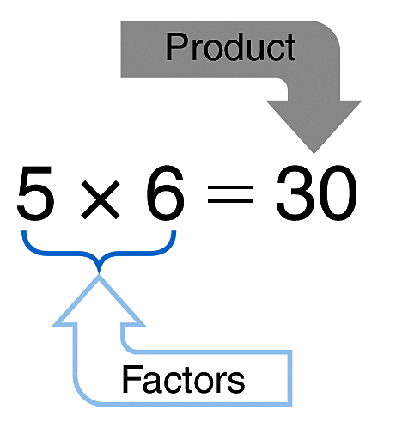
Multiplication
Multiplication is a shortcut method of performing repeated addition.
6 + 6 + 6 + 6 + 6 =
In a multiplication problem the product is the name given to the result of the multiplication. The numbers being multiplied are the factors of the product.

Slide 4
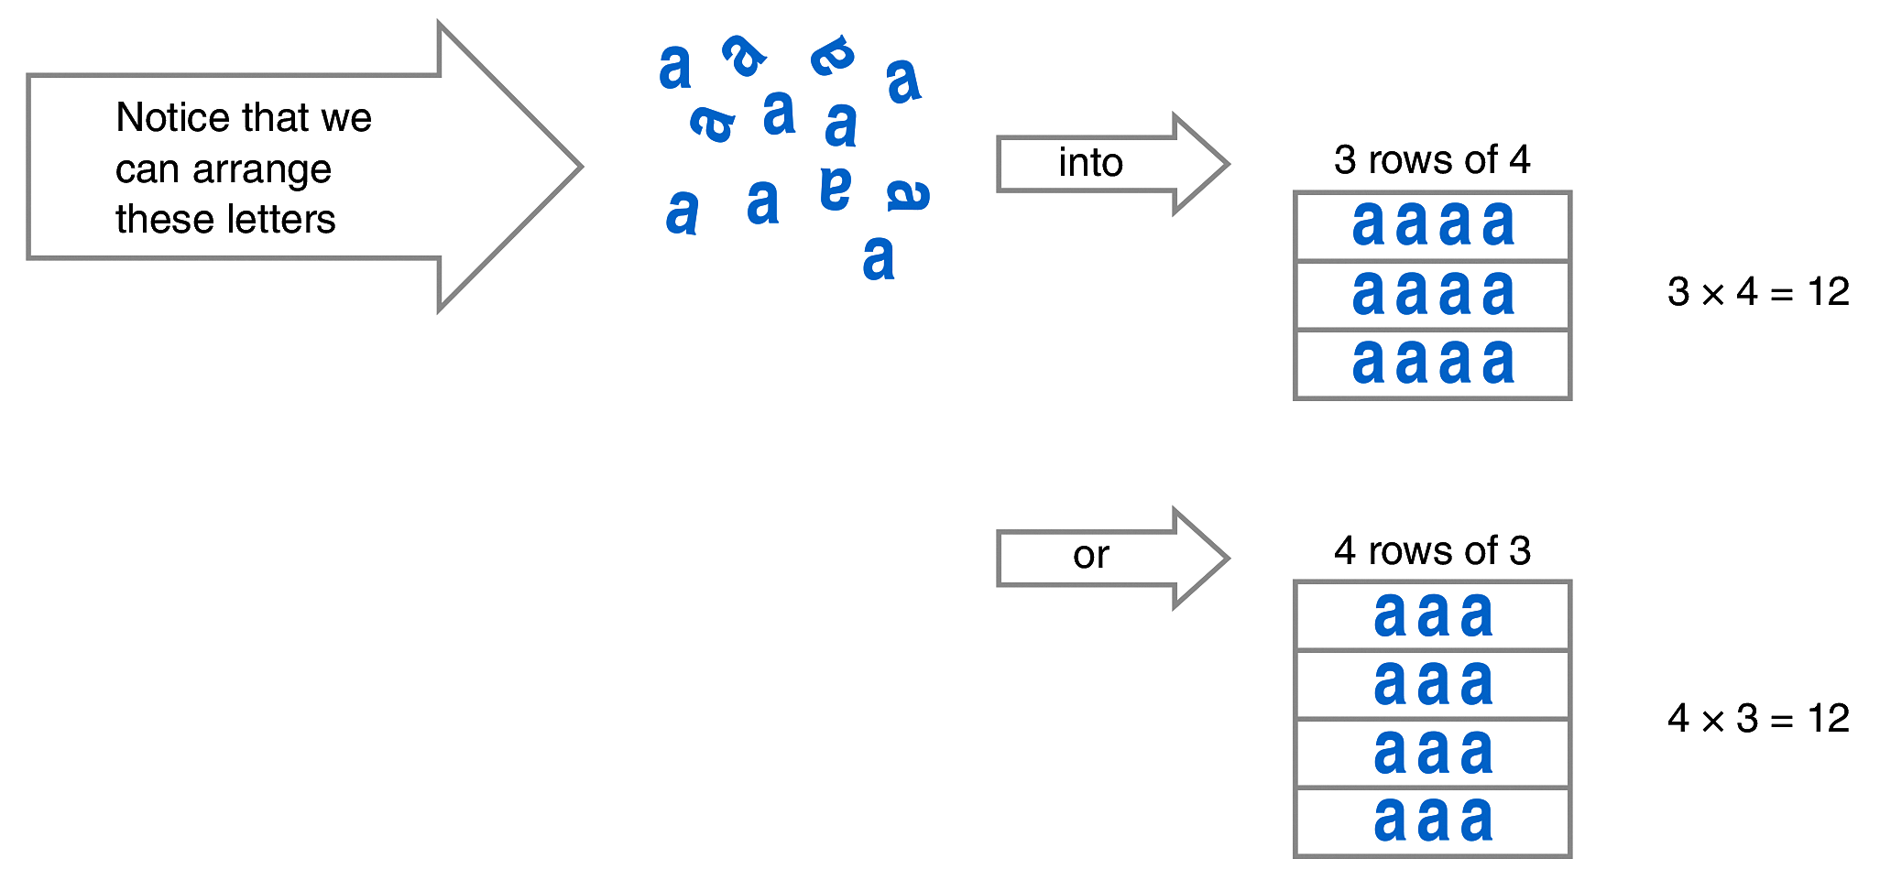
Multiplication
Changing the order of the factors does not change their product. This is called the commutative property of multiplication.

Slide 5
Multiplication
To become skillful at multiplication, you must know the basic one-digit multiplication facts from memory. Even if you use a calculator for your work, you need to know these products to make estimates and to check your work.
If you are not able to perform one-digit multiplications quickly from memory, you should practice until you can do so.

Slide 6
Multiplying by Zero and One
The product of any number and zero is zero.
0 $×$ 2 = 0
0 $×$ 7 = 0
395 $×$ 0 = 0
The product of any number and 1 is that same number.
1 $×$ 2 = 2
6 $×$ 1 = 6
1 $×$ 753 = 753

Slide 7
Six Most Often Missed One-Digit Multiplications

Slide 8
Multiplying by Larger Numbers
The multiplication of larger numbers is based on the one-digit number multiplication facts.

Slide 9
Example
Consider the problem:
34 $×$ 2 = _________
First, estimate the answer: 30 $×$ 2 = 60. The actual product of the multiplication will be about 60.
Second, arrange the factors to be multiplied vertically, with ones digits in a single column, tens digits in a second column, and so on.
3 4
$×$ 2

Slide 10
Example Continued
Consider the problem:
34 $×$ 2 = _________
Finally, to make the process clear, let’s write it in expanded form.
3 4
$×$ 2
3 tens + 4 ones
$×$2
6 tens + 8 ones = 60 + 8 = 68
The estimate 60 is roughly equal to the answer 68.

Slide 11
Example
Here is a slightly more difficult problem. To find the product:
28
$×$ 3
First, estimate the answer: 30 $×$ 3 = 90. The answer is about 90.
Then, proceed as follows:
28
$×$ 3
2 tens + 8 ones
$×$3
6 tens + 24 ones
= 6 tens + 2 tens + 4 ones
= 8 tens + 4 ones
= 80 + 4
= 84

Slide 12
Example Continued
Here is a slightly more difficult problem. To find the product:
28
$×$ 3
90 is roughly equal to 84.
We do not normally use the expanded form; instead we simplify the work
like this:
2
2 8
$×$ 3
3 $×$ 8 = 24 Write 4 and carry 2 tens.
3 $×$ 2 tens = 6 tens 6 tens + 2 tens = 8 tens. Write 8.
8
4

Slide 13
Learning Help
Multiplying a two- or three-digit number by a one-digit number can be done mentally.
For example, think of 43 $×$ 5 as 40 $×$ 5 plus 3 $×$ 5, or 200 + 15 = 215. For a problem such as 29 $×$ 6, think 30 $×$ 6 minus 1 $×$ 6 or 180 – 6 = 174.
Tricks like this are very useful on the job when neither paper and pencil nor a calculator is at hand.

Slide 14
Two- and Three-Digit Multiplications
Calculations involving two- and three-digit multipliers are done in a similar way.

Slide 15
Example
89
$×$24
To multiply
First, estimate the answer: 90 $×$ 20 = 1800
Second, multiply by the ones digit 4.
3
89
$×$24
4 $×$ 9 = 36 Write 6; carry 3 tens.
4 $×$ 8 tens = 32 tens
35
6
32 tens + 3 tens = 35 tens

Slide 16
Example Continued
89
$×$24
To multiply
Estimate the answer: 90 $×$ 20 = 1800
Third, multiply by the tens digit 2.
1
2 $×$ 9 = 18 Write 8; carry 1.
3
89
$×$24
2 $×$ 8 = 16
16 + 1 = 17
35
6
Leave a blank space here, because we are
actually multiplying 89 $×$ 20 = 1780.
17
8

Slide 17
Example Continued
89
$×$24
To multiply
Estimate the answer: 90 $×$ 20 = 1800
Fourth, add the products obtained.
1
3
89
$×$24
35
6
add
17
8
2136

Slide 18
Example Continued
89
$×$24
To multiply
Estimate the answer: 90 $×$ 20 = 1800
Finally, check it. The estimate and the answer are roughly the same, or at least in the same ballpark.
1
3
Notice that the product in the third step, 178, is written one digit space over from the product from the second step. When we multiplied 2 $×$ 9 to get 18 in Step 3, we were actually multiplying 20 $×$9 = 180, but the zero in 180 is usually omitted to save time.
89
$×$24
35
6
17
8
2136

Slide 19
Example
527
$×$231
To multiply
First, estimate the answer: 500 $×$ 200 = 100,000
Next, multiply 527 by each digit in 231, from right to left, creating a separate row for each product. Be sure to indent each row one space to the left of the row above it.
527
$×$231
527
527 $×$ 1
1581
527 $×$ 3
1054
527 $×$ 2
121737
The product is 121,737. This agrees roughly with our estimate.

Slide 20
Multiplication Shortcuts

Slide 21
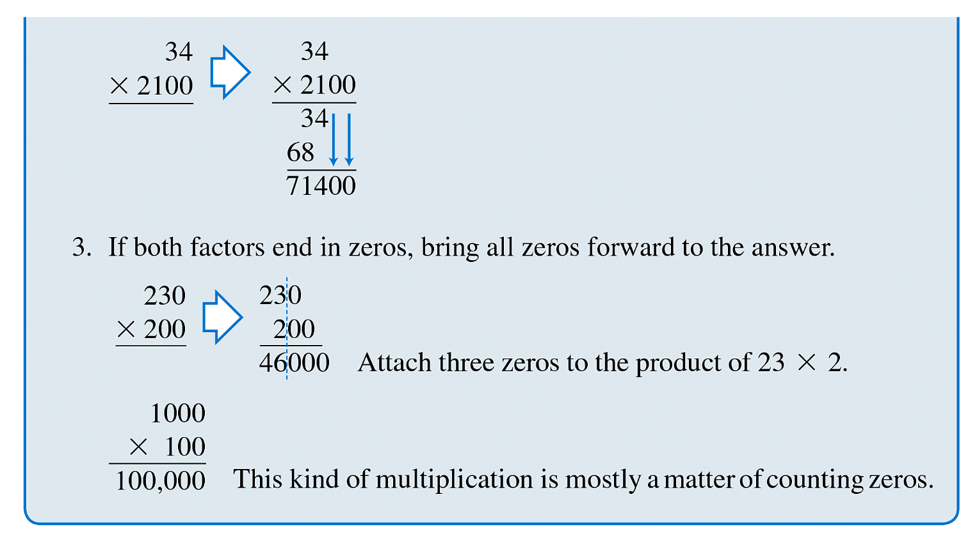
Multiplication Shortcuts

Slide 22
Practical Applications
When we are given a number of items that all have the same numerical value, we use multiplication to find a total.

Slide 23
Example
(a) If a mason works for 40 hours and earns $18 per hour, we multiply
the number of hours by the hourly wage to find the total amount earned:
(b) If an electrician needs 12 pieces of wire that are each 18 inches long, we multiply to find the total length of wire required:

