Slide 1
Chapter 1
Arithmetic of Whole Numbers
Section 1.2
Subtraction of Whole Numbers
Notes:
1

Slide 2
Objectives:
Subtract Whole Numbers
Solve Practical Applications Involving Whole Numbers

Slide 3
Subtraction
Subtraction is the reverse of addition.
Addition: 3 + 4 =
Subtraction: 3 + = 7
7 – 3 =
The difference is the name given to the answer in a subtraction problem.

Slide 4
Example
Here is a more difficult subtraction problem:
47 – 23 = _____
The first step is to estimate the answer.
47 – 23 is roughly 50 – 20 or 30.
The difference, your answer, will be about 30—not 3 or 10 or 300.

Slide 5
Example Continued
Here is a more difficult subtraction problem:
47 – 23 = _____
The second step is to write the numbers vertically, as you did with addition. Be careful to keep the ones digits in line in one column, the tens digits in a second column, and so on.
4 7 – 2 3
Notice that the larger number is written above the smaller number.

Slide 6
Example Continued
Here is a more difficult subtraction problem:
47 – 23 = _____
Once the numbers have been arranged in this way, the difference may be written by performing the following two steps:
Step 1
4 7 – 2 3
ones digits: 7 – 3 = 4
Step 2
2
4
tens digits: 4 – 2 = 2
The difference is 24, which agrees roughly with our estimate.

Slide 7
Example
With some problems, it is necessary to rewrite the larger number before the problem can be solved.
64 – 37 = _____
First, estimate the answer. Rounding to the nearest ten, 64 – 37 is roughly 60 – 40 or 20.
Second, arrange the numbers vertically in columns.
6 4 – 3 7

Slide 8
Example Continued
64 – 37 = _____
Because 7 is larger than 4, we must “borrow” one ten from the 6 tens in 64. We are actually rewriting 64 (6 tens + 4 ones) as 5 tens + 14 ones. In actual practice, our work would look like this:
Step 1
Step 2
Step 3
Borrow one ten, change the 6 in the tens place to 5, change 4 to 14, subtract 14 – 7 = 7.
5
14
5
14
6 4 – 3 7
6 4 – 3 7
6 4 – 3 7
7
2
7

Slide 9
Example Continued
64 – 37 = _____
Double-check subtraction problems by adding the answer (the difference) and the smaller number (the subtrahend); their sum should equal the larger number.
Step 4 Check:
37 + 27
64

Slide 10
Example
To subtract 426 – 128, follow these steps:
Step 1
Step 2
Steps 3 and 4
In this case we borrow twice. Borrow one ten from the 20 in 426 and make 16. Then borrow one hundred from the 400 in 426 to make 11 in the tens place.
1
16
3
11
16
4 2 6 – 1 2 8
4 2 6 – 1 2 8
4 2 6 – 1 2 8
8
2
9
8
3 – 1 = 2 Write 2
11 – 2 = 9 Write 9
16 – 8 = 8 Write 8

Slide 11
Example Continued
To subtract 426 – 128, follow these steps:
Step 1
Step 2
Steps 3 and 4
1
16
3
11
16
4 2 6 – 1 2 8
4 2 6 – 1 2 8
4 2 6 – 1 2 8
8
2
9
8
The answer 298 is approximately equal to the estimate 300.
1
1
Double-check:
1 2 8 + 2 9 8
4 2 6

Slide 12
Example
(a) 400 – 167 = ?
Step 1
Step 2
Step 3
Check
3
10
3
9
10
4 0 0 – 1 6 7
4 0 0 – 1 6 7
4 0 0 – 1 6 7
1 6 7 + 2 3 3
2
3
3
4 0 0
In Steps 2 and 3 we have rewritten 400 as 300 + 90 + 10.

Slide 13
Example Continued
(b) 5006 – 2487 = ?
Step 1
Step 2
Step 3
Step 4
Check
4
10
4
9
10
4
9
9
16
5 0 0 6 – 2 4 8 7
5 0 0 6 – 2 4 8 7
5 0 0 6 – 2 4 8 7
5 0 0 6 – 2 4 8 7
2 4 8 7 + 2 5 1 9
2
5
1
9
5 0 0 6

Slide 14
Practical Applications
When solving word problems, you must look for key words or phrases to help you decide what operation to use. Here are some typical questions that call for subtraction:
“What is the difference between . . . ?”
“How much remains . . . ?” or “How much is left . . . ?”
“By how much is A greater than B?” or “What was the increase from A to B?”
“How much do you save?”

Slide 15
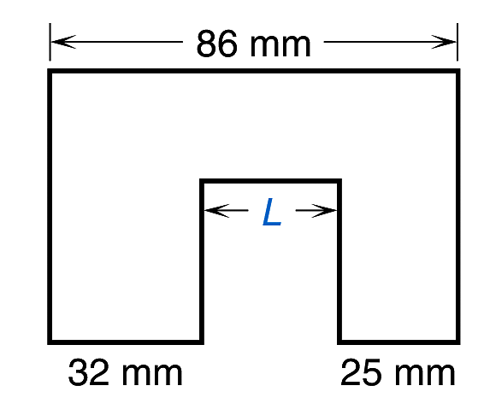
Example
Suppose we need to find the missing dimension L in the drawing. Along the top of the drawing, we have the total horizontal dimension of 86 mm. We can also see that the three lower horizontal dimensions must add up to this total. To find the missing dimension L, we must subtract the other two given dimensions from the total. Therefore, the missing dimension is
L = 86 mm – 32 mm – 25 mm
Estimate: 90 – 30 – 30 = 30

Slide 16
Example Continued
L = 86 mm – 32 mm – 25 mm
Estimate: 90 – 30 – 30 = 30
Step 1
Step 2
4
14
8 6 – 3 2
5 4 – 2 5
5 4
2 9
The missing dimension L is 29 mm. This is very close to our estimate of 30 mm.

Slide 17
Example
When consumers purchase new automobiles these days, they are often faced with the decision of whether to buy the hybrid version of a particular car. The hybrid version usually costs more but saves money over time because of lower fuel costs.

Slide 18
Example Continued
Suppose that a potential car buyer is deciding between a Toyota Camry and a Camry Hybrid. He estimates that he will keep the car at least 5 years and then sell it. He wants to know if the hybrid model will save him money and, if so, how much. The dealer provides him with the following information:

Slide 19
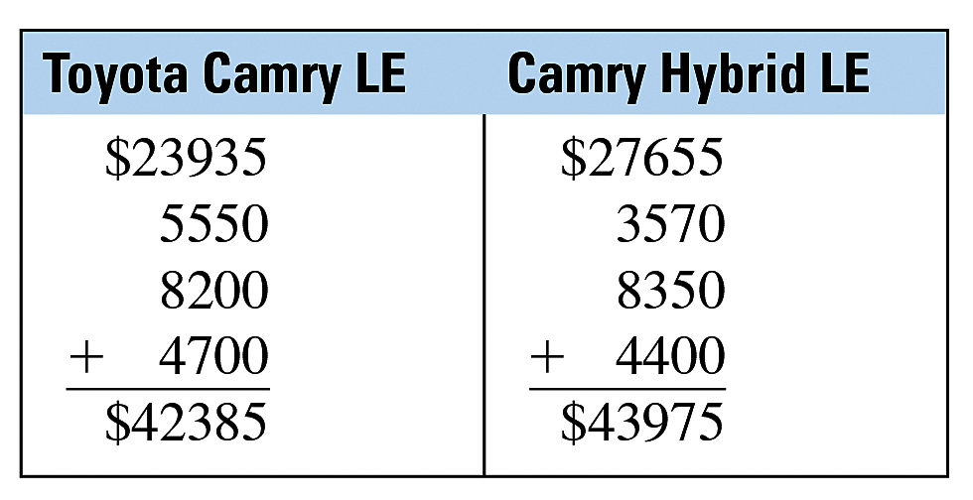
Example Continued
We can use these figures to get a rough estimate of the total 5-year cost of each model.
First, find the sum of the expenditures: The sales price, fuel cost, insurance and
fees, and maintenance and repairs.

Slide 20
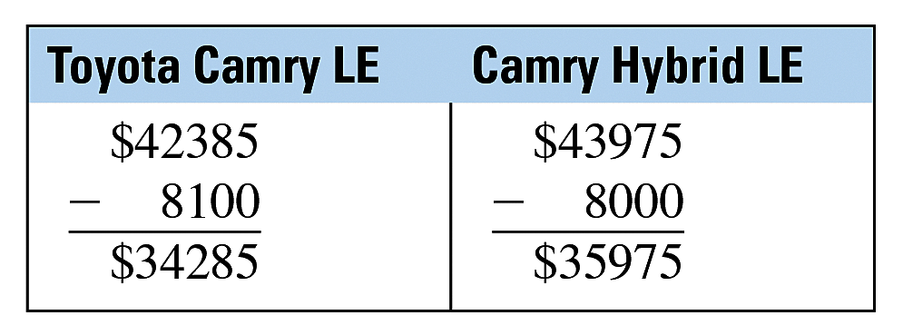
Example Continued
Then, subtract the 5-year resale values from these results.

Slide 21
Example Continued
These figures represent rough estimates of the total 5-year cost of each vehicle.
They show that if the buyer keeps the car he chooses for at least 5 years and then sells it, choosing the non-hybrid Camry LE will save him money.

Slide 22
Example Continued
Finally, find the difference between these two costs to find the total amount of savings.
Camry Hybrid LE:
Toyota Camry LE:
$35975 – 34285
$ 1690
Overall, the non-hybrid Camry LE will save the car buyer $1690 over 5 years
based on initial price, fuel costs, insurance and fees, maintenance and repairs,
and resale values. It should be noted that if the buyer decides to keep the car longer, the continued fuel savings of the hybrid might end up making that model a better buy.

