Slide 1
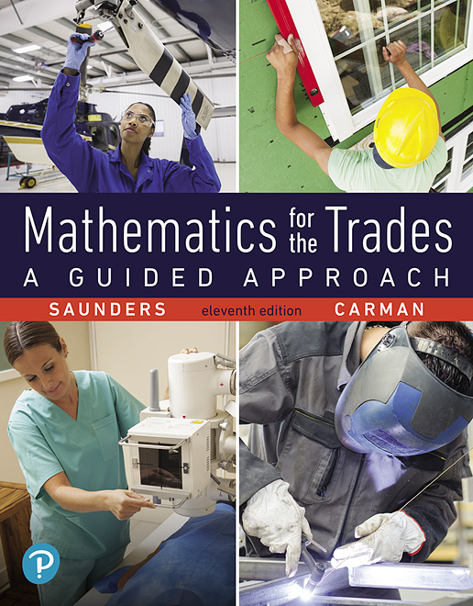
Chapter 1
Arithmetic of Whole Numbers
Section 1.1
Reading, Writing, Rounding, and Adding Whole Numbers
Notes:
1

Slide 2
Objectives:
Write Whole Numbers in Words then Translate Words to Numbers
Round Whole Numbers
Add Whole Numbers
Solve Practical Applications involving Whole Numbers

Slide 3
Whole Numbers
The whole numbers are 0, 1, 2, 3, …, and so on.

Slide 4
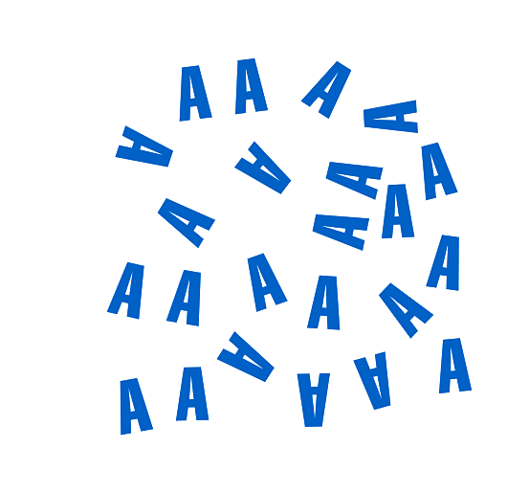
Example
How many letters are in the collection shown?
We can count the letters by grouping them into sets of ten:
2 tens + 3 ones
20 + 3 or 23

Slide 5
Expanded Form
46 = 40 + 6 = 4 tens + 6 ones
874 = 800 + 70 + 4 = 8 hundreds + 7 tens + 4 ones
305 = 300 + 5 = 3 hundreds + 0 tens + 5 ones
Only ten numerals or number symbols—0, 1, 2, 3, 4, 5, 6, 7, 8, and 9—are needed to write any number. These ten basic numerals are called the digits of the number.
The digits 4 and 6 are used to write 46, the number 874 is a three-digit number, and so on.

Slide 6
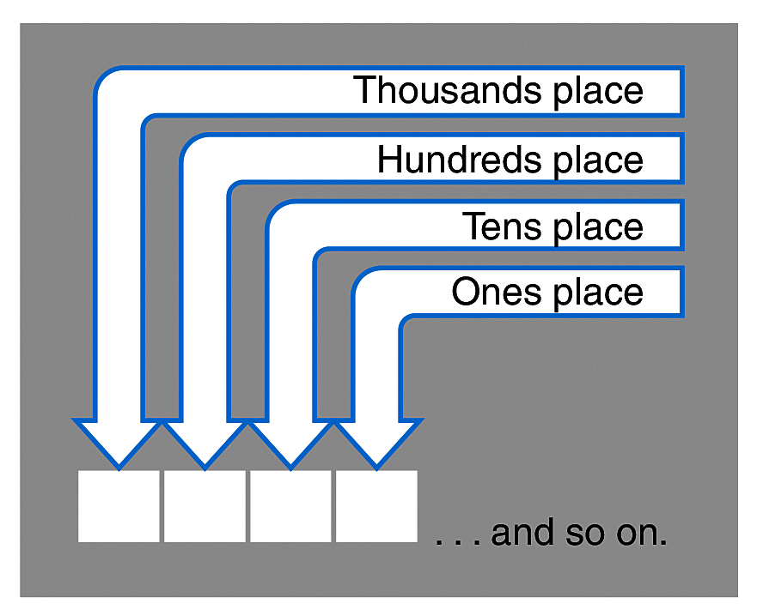
Place Value
Notice that the 2 in 762 means something different from the 2 in 425 or 208.
In 762, the 2 signifies two ones. In 425, the 2 signifies two tens. In 208, the 2 signifies two hundreds.
Ours is a place-value system of naming numbers: the value of any digit depends on the place where it is located.

Slide 7
Reading and Writing Whole Numbers
Expanded-form is useful especially in naming very large numbers. Any large number given in numerical form may be translated to words by using the following diagram:

Slide 8
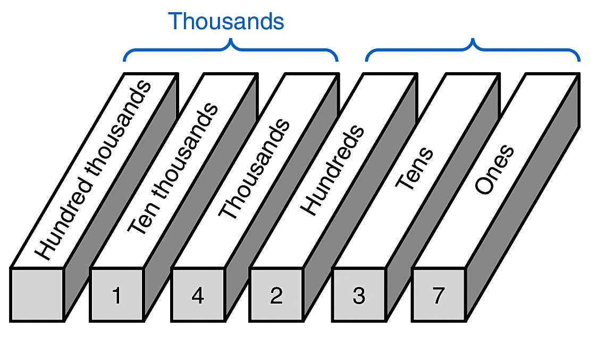
Example
The number 14,237 can be placed in the diagram like this:
The number 14,237 is read “fourteen thousand, two hundred thirty-seven.”

Slide 9
Example
The number 47,653,290,866 becomes:
and is read “forty-seven billion, six hundred fifty-three million, two hundred ninety thousand, eight hundred sixty-six.”

Slide 10
Reading and Writing Whole Numbers
In each block of three digits read the digits in the normal way (“forty-seven,” “six hundred fifty-three”) and add the name of the block (“billion,” “million”). Notice that the word “and” is not used in naming these numbers.

Slide 11
Rounding Whole Numbers
In many situations a simplified approximation of a number is more useful than its exact value. For example, the accountant for a business may calculate its total monthly revenue as $247,563, but the owner of the business may find it easier to talk about the revenue as “about $250,000.”
The process of approximating a number is called rounding. Rounding numbers comes in handy when we need to make estimates or do “mental mathematics.”

Slide 12
Rounding Whole Numbers
A number can be rounded to any desired place. For example, $247,563 is
approximately
$247,560 rounded to the nearest ten,
$247,600 rounded to the nearest hundred,
$248,000 rounded to the nearest thousand,
$250,000 rounded to the nearest ten thousand, and
$200,000 rounded to the nearest hundred thousand.

Slide 13
Example
To round a whole number, follow this step-by-step process:
to the nearest hundred thousand
to the nearest ten thousand
Round 247,563
Step 1 Determine the place to which the number is to be rounded. Mark it on the right with a $⋀$.
$2$⋀$47,563
$24$⋀$7,563
Step 2 If the digit to the right of the mark is less than 5, replace all digits to the right of the mark with zeros.
4 < 5, round down
$200,000
7 > 5, round up
Step 3 If the digit to the right of the mark is equal to or larger than 5, increase the digit to the left by 1 and replace all digits to the right with zeros.
$250,000

Slide 14
Addition of Whole Numbers
The answer to an addition problem is called the sum.
Adding one-digit numbers is very important. It is the key to many mathematical computations—even if you do the work on a calculator. But you also must be able to add numbers with two or more digits.
Suppose that, as a contractor, you need to find the total time spent on a job by two workers who have put in 31 hours and 48 hours, respectively. You will need to find the sum
31 hours + 48 hours = ______.

Slide 15
Estimating
The first step is to estimate your answer. The most important rule in any mathematical calculation is:
Rounding to the nearest 10 hours, the sum can be estimated as
30 hours + 50 hours = 80 hours.
Once you have a rough estimate of the answer, you are
ready to do the arithmetic work.

Slide 16
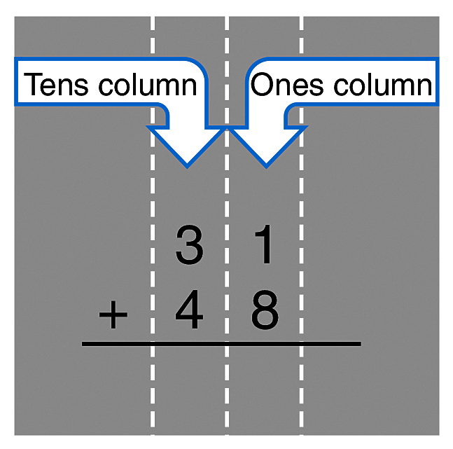
Estimating
31 hours + 48 hours = ________
Set it up like this:
The numbers to be added are arranged vertically (up and down) in columns.
The right end or ones digits are placed in the ones column, the tens digits are placed in the tens column, and so on.

Slide 17
Estimating
Most often the cause of errors in arithmetic is carelessness, especially in simple tasks such as lining up the digits correctly.
Once the digits are lined up the problem is easy.
31
First, find the sum of the ones column: 1 + 8 = 9
+ 48
Then, find the sum of the tens column: 3 + 4 = 7
7
9
Does the answer agree with your original estimate? Yes. The estimate, 80, is roughly equal to the actual sum, 79.

Slide 18
Guess and Check Method
The guess and check method of doing mathematics
1. Estimate the answer using rounded numbers.
2. Work the problem carefully.
3. Check your answer against the estimate. If they disagree, repeat both Steps 1 and 2. The check icon reminds you to check your work.
The guess and check method means that you never work in the dark; you always know where you are going.
Estimating is especially important in practical math, where a wrong answer is not just a mark on a piece of paper. An error may mean time and money lost.

Slide 19
Example
27 lb + 58 lb = ____________
First, estimate the answer. 27 + 58 is roughly 30 + 60 or about 90 lb.
Second, line up the digits in columns.
27
addends
+ 58
1
Third, add carefully.
27
+ 58
85
Finally, check your answer by comparing it with the estimate. The estimate 90 lb is roughly equal to the answer 85 lb—at least you have an answer in the right ballpark.

Slide 20
A Closer Look
What does that little 1 above the tens digit mean?
2 tens + 7 ones
5 tens + 8 ones
= 7 tens + 15 ones
1
27
= 7 tens + 1 ten + 5 ones
+ 58
85
= 8 tens + 5 ones
= 85
The 1 that is carried over to the tens column is really a ten.

Slide 21
Example
To add 536 + 1473 + 875 + 88
Estimate: Rounding each number to the nearest hundred,
500 + 1500 + 900 + 100 = 3000
Step 1 To help avoid careless errors, put the number with the most digits, 1473,
on top. Put the number with the fewest digits, 88, on the bottom.
1473
536
875
+ 88

Slide 22
Example Continued
To add 536 + 1473 + 875 + 88
Estimate: Rounding each number to the nearest hundred,
500 + 1500 + 900 + 100 = 3000
2
Step 2
1473
536
3 + 6 + 5 + 8 = 22 Write 2; carry 2 tens
875
+ 88
2

Slide 23
Example Continued
To add 536 + 1473 + 875 + 88
Estimate: Rounding each number to the nearest hundred,
500 + 1500 + 900 + 100 = 3000
2
2
Step 3
1473
536
2 + 7 + 3 + 7 + 8 = 27 Write 7; carry 2 hundreds
875
+ 88
7
2

Slide 24
Example Continued
To add 536 + 1473 + 875 + 88
Estimate: Rounding each number to the nearest hundred,
500 + 1500 + 900 + 100 = 3000
1
2
2
Step 4
1473
536
2 + 4 + 5 + 8 = 19 Write 9; carry 1 thousand
875
+ 88
9
7
2

Slide 25
Example Continued
To add 536 + 1473 + 875 + 88
Estimate: Rounding each number to the nearest hundred,
500 + 1500 + 900 + 100 = 3000
1
2
2
Step 5
1473
536
1 + 1= 2 Write 2.
875
+ 88
2
9
7
2
Check: The estimate 3000 and the answer 2972 are very close.

Slide 26
Importance of Estimating
Estimating answers is a very important part of any mathematics calculation, especially for the practical mathematics used in engineering, technology, and the trades.
A successful builder, painter, or repairperson must make accurate estimates of job costs—business success depends on it.
If you work in a technical trade, getting and keeping your job may depend on your ability to get the correct answer every time.
If you use a calculator to do the actual arithmetic, it is even more important to get a careful estimate of the answer first.

Slide 27
Practical Applications
Once you learn a basic math skill, you must also learn how to apply that skill to a real-world situation
Word problems that call for addition often contain key questions such as “how many . . .?” or “what is the total number of . . .?”
Look for these clues that indicate you must add to find the answer.

Slide 28
Example
In order to accommodate the weight of their equipment, the California Highway Patrol is now using an SUV instead of a sedan as their primary vehicle. The additional equipment they carry includes a push bumper (54 lb), a computer (12 lb), a gun tub with rifles (32 lb), a light bar (30 lb), a prisoner barrier (56 lb), radio and video equipment (270 lb), and other miscellaneous supplies such as flares, first aid supplies, and traffic cones (50 lb). What is the total weight of the additional equipment listed?
Calculate:
Estimate: 50 + 10 + 30 + 30 + 60 + 270 + 50 = 500
The new SUVs will need to carry 504 lb of additional equipment. Notice that the estimate is very close to the final answer.

Slide 29
Units of Measure
Units of measure are important in every trade. Just as you want to make sure that a customer is not thinking in centimeters while you are thinking yards, you will want to make sure that the measurements required for a project have consistent units.

Slide 30
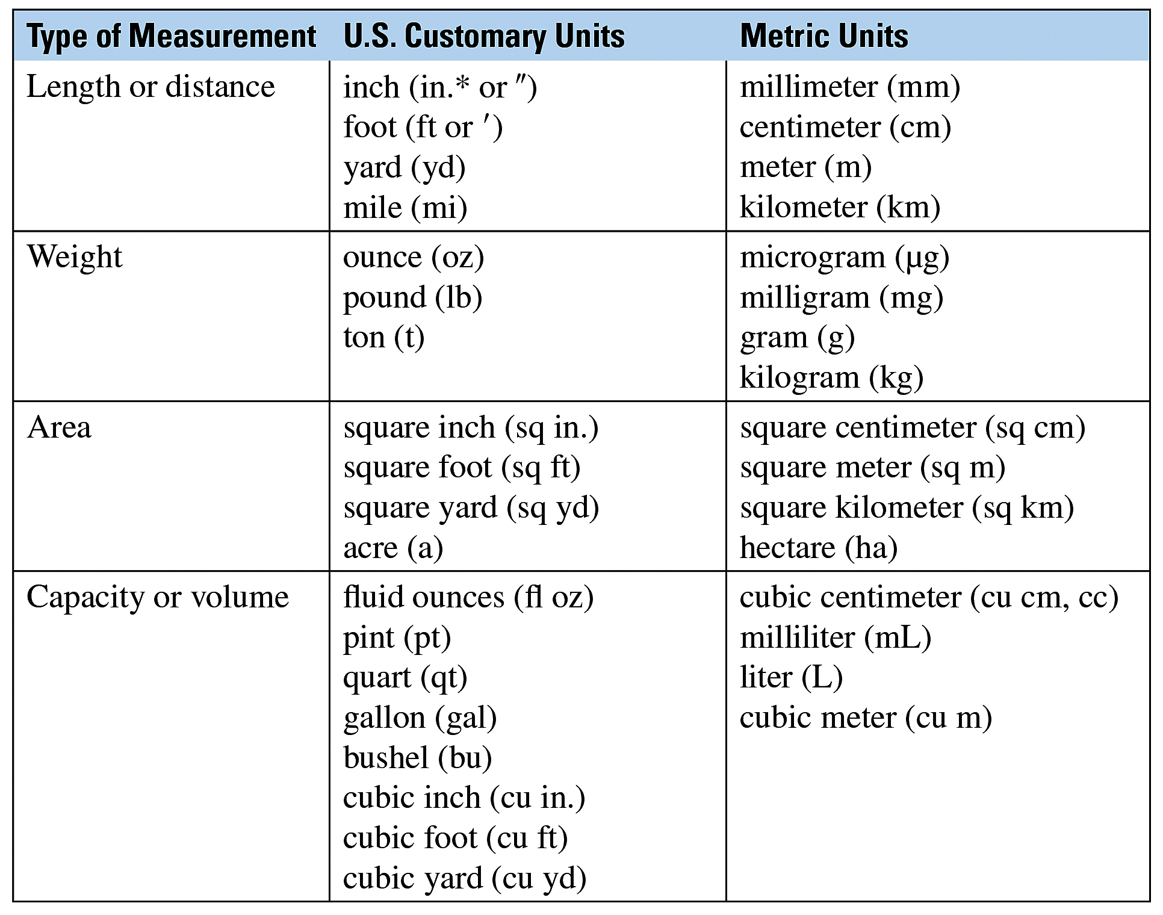
Units of Measure

Slide 31
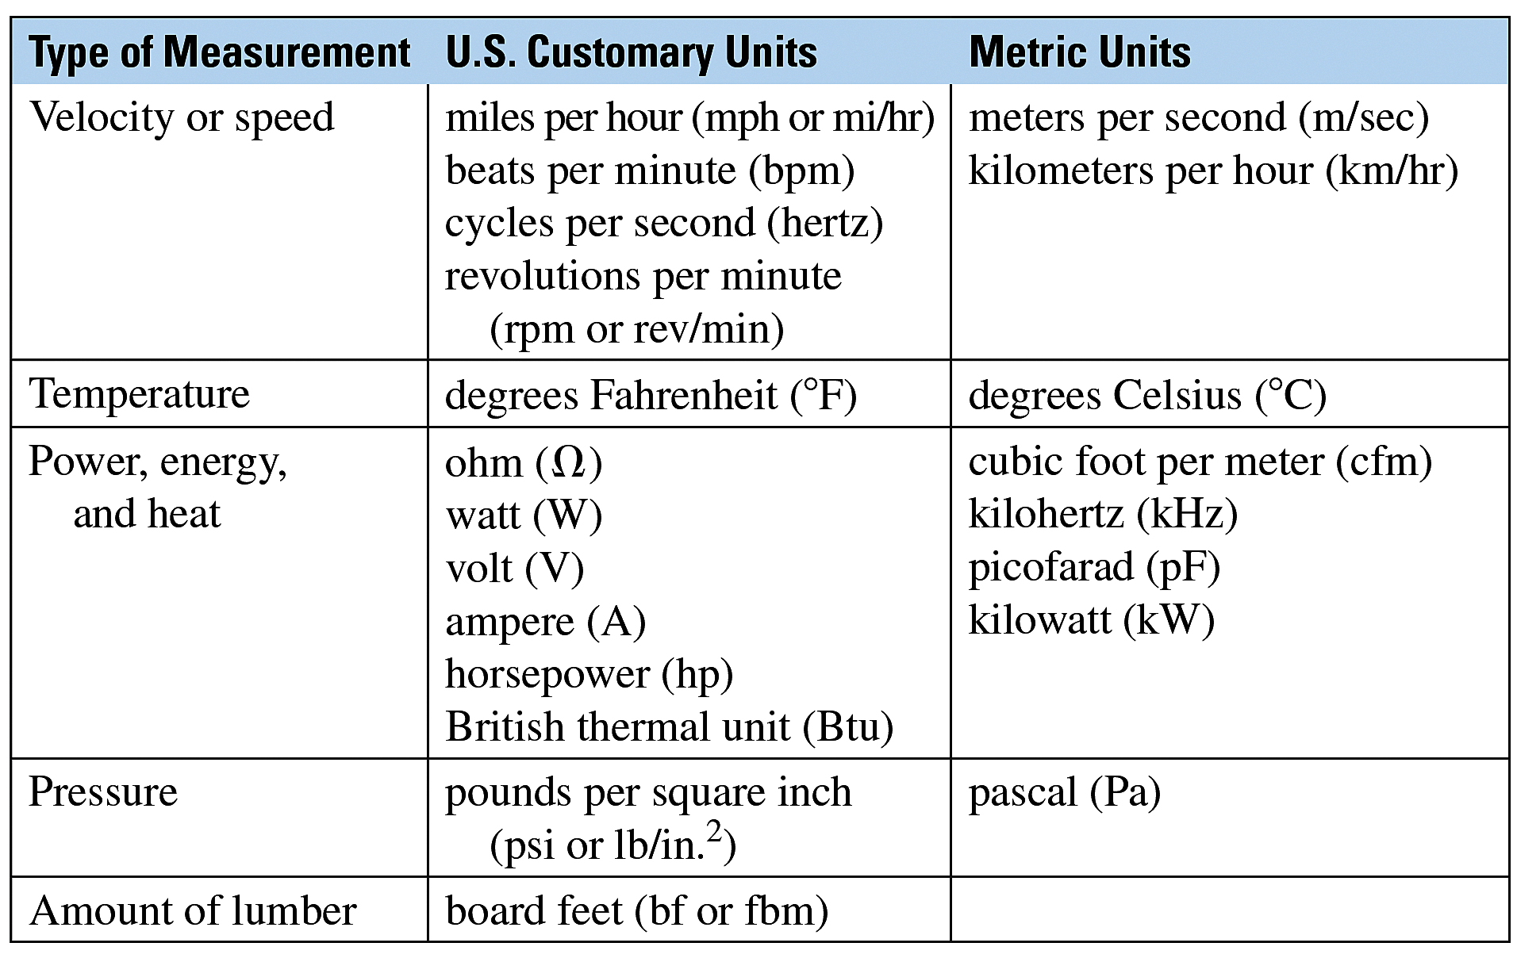
Units of Measure

